Slide 1
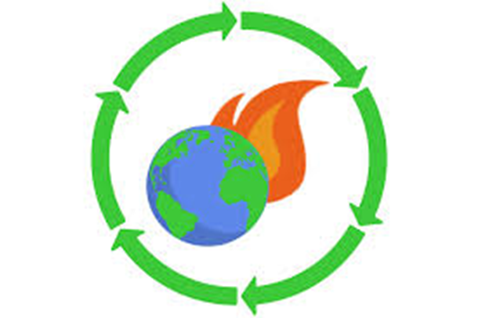

Ecosystem-Disaster Risk Reduction and Climate Change Adaptation
ADD ON COURSE
DEPARTMENT OF ENVIRONMENTAL STUDIES

Slide 2
This is the most comprehensive course available for the field today. It is based on the context of global climate change and population growth, the number of natural and human-made emergencies every year has increased drastically in the past decade. Although floods, earthquakes, droughts, and other natural hazards cannot be prevented, their impact on communities can be limited through disaster risk reduction (DRR) practices.
The purpose of this course is to encourage and practice Disaster Risk Reduction (DRR) and Climate Change Adaptation (CCA) approaches that encompass prevention, risk mitigation, preparedness, risk sharing and response to disaster events to protect lives and improve livelihoods.

Slide 3
This course is a UN recommended course and the syllabus is as per the UN syllabus.

Slide 4
Intro..
Semester : 1
No. of credits : 2
No. of contact hours : 36
Syllabus is available on the college website

Slide 5
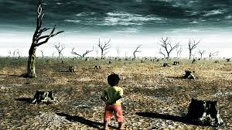
Course Description
Climate change is known to increase disaster intensities and frequency by aggravating hazards and the factors determining vulnerability of environment, inhabiting communities and their resources.
There has been a paradigm shift in approach to disaster management from response and relief centric to risk management centric, and thus, calling integration of climate change adaptation and sustainability concerns along DRR into developmental process.
This course introduces the concepts, tools, methods for disaster risk management, specifically for climate and weather-related disasters; role of policies and frameworks at international, national and sub-national contexts, with focus on emerging issues and recent developments.

Slide 6
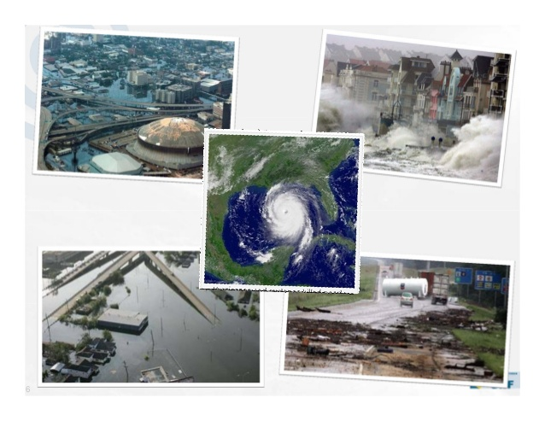

Slide 7

Disaster Risk Reduction (DRR)
Disaster Risk Reduction (DRR) is the concept and practice of reducing disaster risks through:
analysing and management of their causal factors
reducing exposure to hazards
lessen the vulnerability of people and assets
improving management of the land and environment
preparing for adverse events

Slide 8

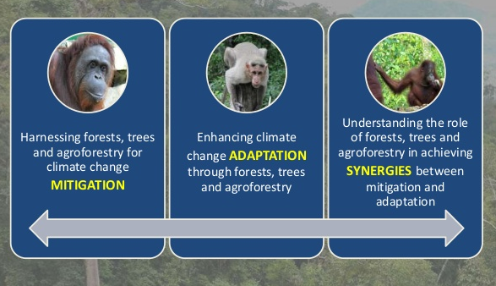
Climate Change Adaptation (CCA)
Adaptation refers to changes in processes, practices, and structures to moderate potential damages or to benefit from opportunities associated with climate change. This includes:
  adjusting ecological, social, or economic systems in response to actual
or expected climatic stimuli and their effects or impacts.
  adapting development to gradual changes in average temperature, sea level and precipitation; and
  reducing and managing the risks associated with more frequent, severe and unpredictable extreme weather events

Slide 9
The course will cover topics including:
What is DRR and climate change and its different types of impacts – and how DRR needs to take account of these differences
Understanding the social construction of disasters, and their links with climate change and development
Gender issues in the context of climate change adaptation and disaster preparedness
Knowledge and power: integrating indigenous and external knowledge for effective DRR
Adaptation in the face of the unknown: how do people adapt to uncertainty?
Assessing vulnerability and capacity: using participatory tools for risk reduction
Integrating early-warning systems in regard to climate-related hazards
Community-based disaster risk reduction: constraints and benefits

Slide 10
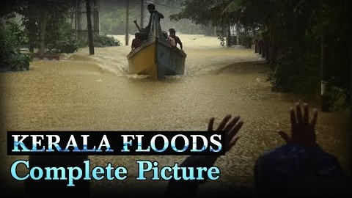
Worst flood in Kerala

Slide 11
Course objectives
Understanding of different types of disasters and its causes and impacts on the society, region and environment.
Learning and analyzing the vulnerability, its implications and the practical processes involved in, the management of disasters at various levels.
Assessing the challenges and limitations involved in the response and recovery during and post disasters.
Equip students with knowledge of various Ecosystems - Disaster Risk Reduction and Climate Change Adaptation and make students aware and understand the importance.
It will generate more interdisciplinary interest and knowledge products in due course.

Slide 12

OUTCOMES
Students would widen their perspectives to realize that hazards become disasters only if they are poorly managed and that disaster management can be significantly improved by adding ecosystem components.
Understand the interrelations between humans and their natural environment.
Understand the linkages between global environmental problems and disasters.

Slide 13
3. Understand that sustainable land and ecosystem management will reduce disaster risk.
4. Understand the importance of the Sustainable Development Goals (SDG) for disaster risk reduction.

Slide 14
Opportunities
To having certificate in this course would facilitate in getting in the governmental and in the private organisations as well as in the UN programmes
Opportunities in Government agencies:
Employment opportunities are offered in the disaster management departments of government agencies such as: Fire departments, drought management departments, law enforcement authorities, relief agencies etc and Insurance companies, industries in the high-risk fields like chemicals, mining, and petroleum which have their own disaster management cells.

Slide 15
Private sector
Various opportunities are also offered in the fields of teaching, research, consultancy, documentation, training organizer, field training and mock driller expert.
One can serve as social workers, engineers, medical health experts, environmental experts, rehabilitation workers, etc.
NGOs and International organizations such as World Bank, Asian Development Bank (ADB), United Nations Organizations (UNO), Red Cross, UNESCO offer various opportunities for professionally trained disaster management professionals

Slide 16
Some organizations that offer jobs with this course certificate
SAARC Disaster Management Centre, NIDM Building, New Delhi.
National Institute of Disaster Management (NIDM), Ministry of Home Affairs, Govt. of India, New Delhi.
National Disaster Management Authority, Near Indira Gandhi International Airport, New Delhi.
Indian Institute of Public Administration (IIPA), Indraprastha Estate, Ring Road, New Delhi.
India Meteorological Department, Lodhi Road, New Delhi.
Centre of Disaster Management, HCMRIPA, JLN Marg, Jaipur.
Haryana Institute of Public Administration (HIPA), Gurgaon.

Slide 17
National Institute of Disaster Management (NIDM), Ministry of Home Affairs, Govt. of
Ambedkar Institute of Public Administration, Chandigarh.
Shri Krishna Institute of Public Administration, Ranchi.
G.B.Pant Institute of Himalayan Environment and Development, Nainital, Uttarakhand.
Disaster Management Centre, Bhopal.
Disaster Mitigation Institute, Ahmedabad.
Centre for Disaster Management, Guru Govind Singh Indraprastha University, Kashmeri Gate, Delhi.

Slide 18
Indian Agriculture Research Institute (ICAR), New Delhi.
Indian Red Cross Society, New Delhi and States Units.
States Revenue and Disaster Management Ministry/Department.
State Government’s Institute of Public Administration.
National Remote Sensing Centre, Department of Space, Govt. of India, Hyderabad.
Space Applications Centre, Department of Space, Govt. of India, Ahmedabad.
Indian Institute of Remote Sensing, Department of Space, Govt. of India, Dehradun.

Slide 19
National Institute of Ocean Technology, Chennai.
United Nations Development Programme (UNDP) of national level and State Units.
Faculty and research positions in universities/institutes and in foreign countries.
Organizations providing fellowships for Disaster Prevention and Management Study.
Indian and international level Non-Governmental Organizations (NGO) working in the field of Disasters Management.
Remote Sensing Applications Centers in state, Kerala, in the county or abroad,

Slide 20

Disaster Risk Reduction and Climate Change Adaptation informational video

Slide 21
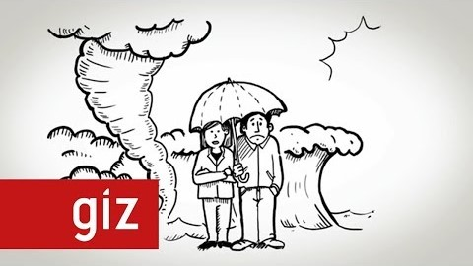
Climate Change Adaptation: it's time for decisions now | GIZ

Slide 22
THANK YOU

