Slide 1
Types of Value Added Services

Slide 2
Types of Value Added Services
Consumer Value Added Services
Network Value Added Services
Enterprise Value Added Services

Slide 3
Consumer Value Added Services
This type of value added service is directly availed by the end user
Examples
JustDial
OLA cabs

Slide 4
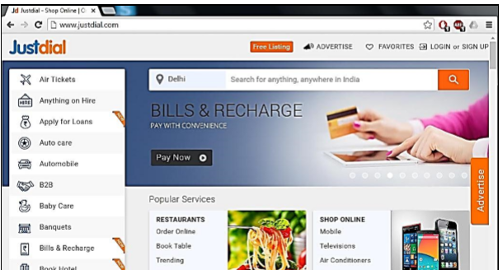
JustDial

Slide 5
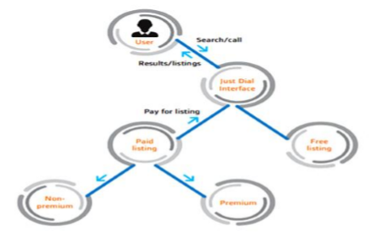
JUSTDIAL BUSINESS MODEL

Slide 6
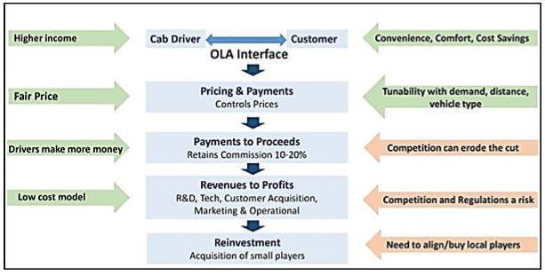
OLA BUSINESS MODEL

Slide 7
Network Value Added Services
This type of VAS refer to technical platforms used by mobile service provider to deliver services to the end user.
Example
IVR
CMS
WAP

Slide 8
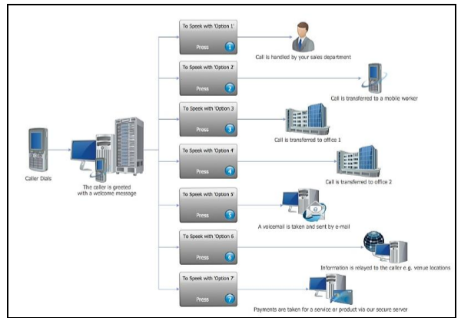
IVR

Slide 9
Enterprise value added services
This type of VAS refer to services offered to enterprises or organisations.
Enterprises uses this type of value added services to enable their professionals to stay connected and perform tasks using wireless mobile devices

Slide 10
THANK YOU

