Slide 1
Principles of Database Design
Santhosh Kumar K P
Asst. Professor,
Dept. of Computer Science
SH College Thevara

Slide 2
Introduction to
Database Management System

Slide 3
Data: structured, semi-structured and unstructured data
Data: Known facts that can recorded and that has implicit meaning.
Structured data: Information stored in databases is known as structured data because it is represented in a strict format.
The DBMS then checks to ensure that all data follows the structures and constraints specified in the schema.

Slide 4
Data: structured, semi-structured and unstructured data
Unstructured data, because there is very limited indication of the type of data.
Example: File (text, excel, pdf etc)

Slide 5
Data: structured, semi-structured and unstructured data
This data may have a certain structure, but not all the information collected will have identical structure. This type of data is known as semi-structured data.
In semi-structured data, the schema information is mixed in with the data values, since each data object can have different attributes that are not known in advance.
Example: Email (email id, subject, body, file(unstructured))

Slide 6
Data base
Database: is a collection of related data.
Traditional database: text, numbers
Multimedia database: videos, mp3, movies
GIS(geographical information system): satellite images
Real Time db: related to time, eg: used in supermarket
Data Warehouse: huge and historical

Slide 7
Database Management System (DBMS)
DBMS is a general purpose software system that facilitates the process of defining, constructing, manipulating and sharing databases among various users and applications.
Defining a database involves specifying the data types, structures, and constraints of the data to be stored in the database
Constructing the database is the process of storing the data on some storage medium that is controlled by the DBMS.
Manipulating is querying the database to retrieve specific data, updating the database, generating reports from the data
Sharing a database allows multiple users and programs to access the database simultaneously.

Slide 8
Database Applications:
Banking: all transactions
Airlines: reservations, schedules
Universities: registration, grades
Sales: customers, products, purchases
Manufacturing: production, inventory, orders, supply chain
Human resources: employee records, salaries, tax deductions

Slide 9
Drawbacks of using file systems to store data:
Data redundancy and inconsistency
Multiple file formats, duplication of information in different files
Difficulty in accessing data
Need to write a new program to carry out each new task
Data isolation — multiple files and formats
Integrity problems
Integrity constraints (e.g. account balance > 0) become part of program code
Hard to add new constraints or change existing ones

Slide 10
Drawbacks of using file systems to store data:
Atomicity of updates
Failures may leave database in an inconsistent state with partial updates carried out
E.g. transfer of funds from one account to another should either complete or not happen at all
Concurrent access by multiple users
Concurrent accessed needed for performance
Uncontrolled concurrent accesses can lead to inconsistencies
E.g. two people reading a balance and updating it at the same time
Security problems

Slide 12
Three-Schema Architecture
External schemas/High level at the external level to describe the various user views.
Conceptual schema at the conceptual level to describe the structure and constraints for the whole database for a community of users. Uses a conceptual or an implementation data model.
Internal schema/low level at the internal level to describe physical storage structures and access paths. Typically uses a physical data model.

Slide 13
Three-Schema Architecture
Mappings among schema levels are needed to transform requests and data.
Programs refer to an external schema, and are mapped by the DBMS to the internal schema for execution.

Slide 14
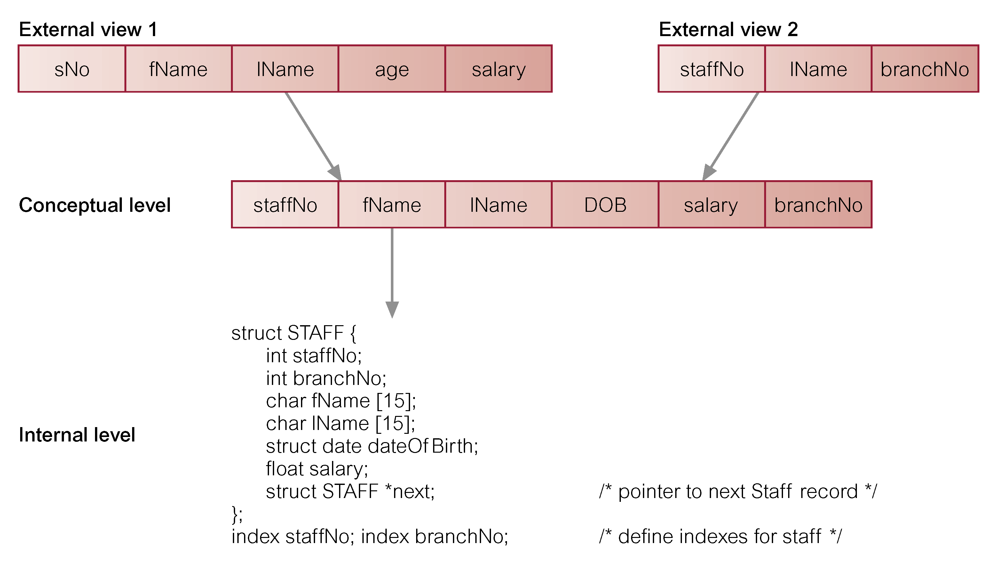

Slide 15
Three-Schema Architecture
Data Independence: The capacity to change the schema at one level of the database system without changing the schema at next higher level.
Two types
Logical Data Independence: The capacity to change the conceptual schema without having to change the external schemas and their application programs.
Physical Data Independence: The capacity to change the internal schema without having to change the conceptual schema.

Slide 16
Actors on the Scene
Database Administrators: Coordinates all the activities of the database system; the database administrator has a good understanding of the enterprise’s information resources and needs.
Duties:
Schema definition
Storage structure and access method definition
Schema and physical organization modification
Granting user authority to access the database
Specifying integrity constraints
Monitoring performance and responding to changes in requirements

Slide 17
Actors on the Scene
Database Designers are responsible for identifying the data to be stored in the database and for choosing appropriate structures to represent and store this data.
End Users: are the people whose jobs require access to the database for querying, updating, and generating reports: Database is already developed for their use.

Slide 18
Actors on the Scene: Software Engineers
System analysts determine the requirements of end users, especially naive and parametric end users, and develop specifications
Application programmers implement these specifications as programs; then they test, debug, document, and maintain these canned transactions.

Slide 19
Data models
Relatively simple representations, usually graphical, of complex real-world data structures
Facilitate interaction among the designer, the applications programmer, and the end user
End-users have different views and needs for data
Data model organizes data for various users

Slide 20
The Evolution of Data Models
Hierarchical
Network Record based
Relational
Entity relationship
Object oriented (OO) Object based

Slide 21
Hierarchical Data Model
The hierarchical structure contains levels, or segments.
Basic logical structure is represented by an upside-down “tree”
Depicts a set of one-to-many (1:M) relationships between a parent and its children segments
Each parent can have many children
each child has only one parent

Slide 22
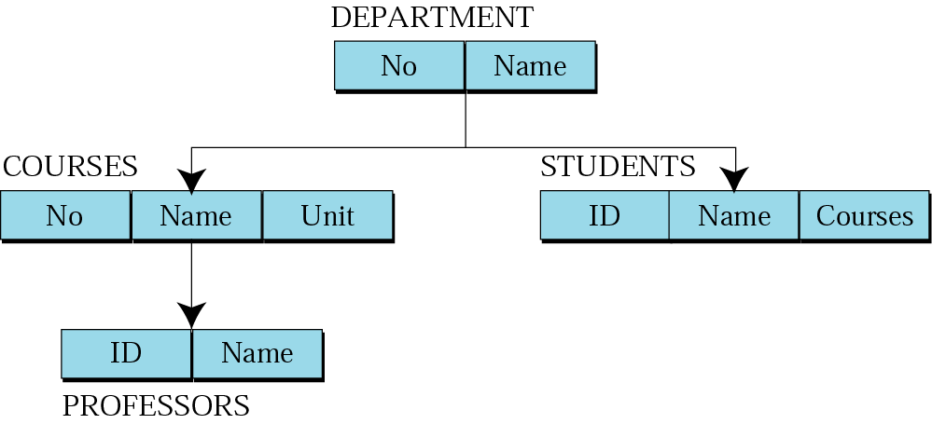
To retrieve data: Starts from Top and traverse different levels to bottom.

Slide 23
Hierarchical Data Model
Advantage
Promote data sharing
Simple: parent child development
Efficient in 1:M relationships
Disadvantage
Requires knowledge about hierarchical paths
No multi-parent relationship
Lack of standards

Slide 24
Network Data Model
Resembles hierarchical model
Data is represented as Collection of records in 1:M relationships
Set
Relationship
Composed of at least two record types
Owner
Equivalent to the hierarchical model’s parent
Member
Equivalent to the hierarchical model’s child

Slide 25
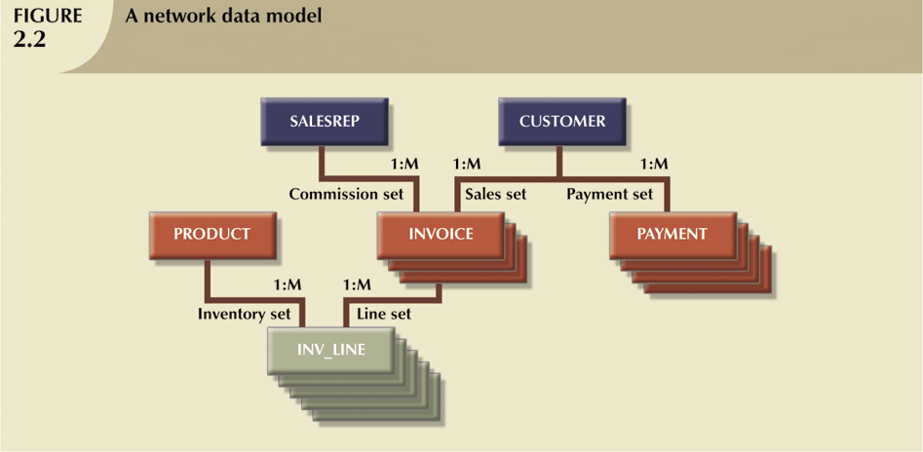

Slide 26
Network Data Model
Advantage
Support multi-parent
Flexible than hierarchical system
Disadvantage
Complex in implementation development, management
Complex limits efficiency

Slide 27
Relational Data Model
Table (relations)
Matrix consisting of a series of row/column intersections
Related to each other through sharing a common entity characteristic
Relational diagram
Representation of relational database’s entities, attributes within those entities, and relationships between those entities

Slide 28
Relational Data Model
Relational Table
Stores a collection of related entities
Relational table is purely logical structure
How data are physically stored in the database is of no concern to the user or the designer
This property became the source of a real database revolution

Slide 30
Entity Relationship Model
Entity relationship diagram (ERD)
Uses graphic representations to model database components
Entity is mapped to a relational table
Entity instance (or occurrence) is row in table
Entity set is collection of like entities
Connectivity labels types of relationships
Diamond connected to related entities through a relationship line

Slide 32
Object Oriented Model
Object is an abstraction of a real-world entity
Attributes describe the properties of an object
Includes information about relationships between facts within object, and relationships with other objects
Subsequent OODM development allowed an object to also contain all operations
Object becomes basic building block for autonomous structures

Slide 33
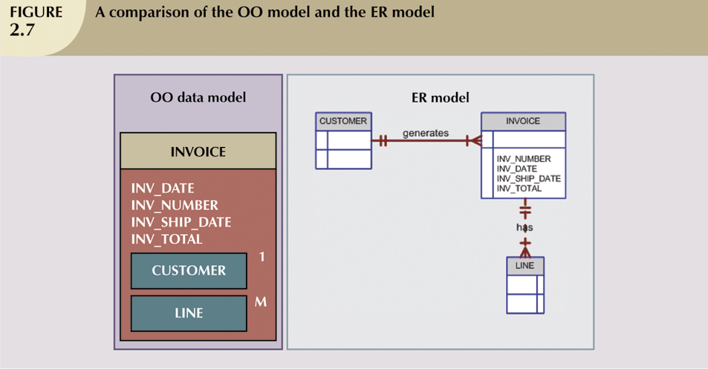

Slide 34
Database Languages
Data Definition Language (DDL)
Data Manipulation Language (DML)

Slide 35
Data Definition Language (DDL)
A language that allows DBA or user to describe and name the entities, attributes and relationships required for an application, together with any associated integrity and security constraints

Slide 36
Data Manipulation Language (DML)
Language for accessing and manipulating the data organized by the appropriate data model
DML also known as query language
Two classes of languages
Procedural – user specifies what data is required and how to get those data
Nonprocedural – user specifies what data is required without specifying how to get those data
SQL is the most widely used query language

Slide 37
Database System Environment/ Component Modules

Slide 39
Component Modules
The DBA staff works on defining the database and tuning it by making changes to its definition using the DDL and other privileged commands.
The DDL compiler processes schema definitions, specified in the DDL, and stores descriptions of the schemas (meta-data) in the DBMS catalog.
The catalog includes information such as the names and sizes of files, names and data types of data items, storage details of each file, mapping information among schemas, and constraints.

Slide 40
Component Modules
Casual users and persons with occasional need for information from the database interact using some form of interface, which we call the interactive query interface

Slide 41
Database System Architectures
Centralized and Client-Server Systems
Server System Architectures
Parallel Systems
Distributed Systems
Network Types

Slide 42
Centralized Systems
Run on a single computer system and do not interact with other computer systems.
General-purpose computer system: one to a few CPUs and a number of device controllers that are connected through a common bus that provides access to shared memory.
Single-user system (e.g., personal computer or workstation): desk-top unit, single user, usually has only one CPU and one or two hard disks; the OS may support only one user.
Multi-user system: more disks, more memory, multiple CPUs, and a multi-user OS. Serve a large number of users who are connected to the system vie terminals. Often called server systems.

Slide 43
Centralized Systems

Slide 44
Client-Server Systems
Server systems satisfy requests generated at m client systems, whose general structure is shown

Slide 45
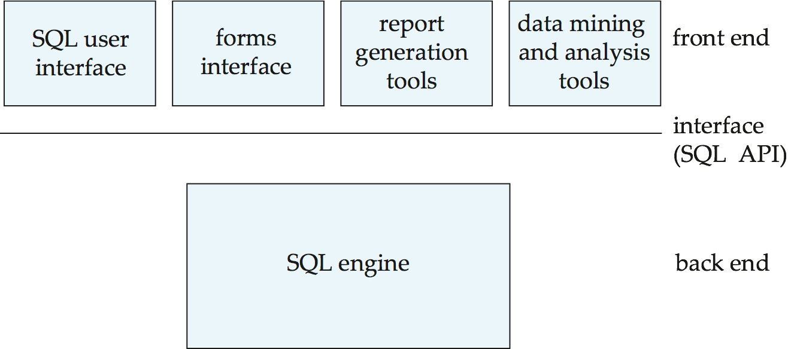
Database functionality can be divided into:
Back-end: manages access structures, query evaluation and optimization, concurrency control and recovery.
Front-end: consists of tools such as forms, report-writers, and graphical user interface facilities.
The interface between the front-end and the back-end is through SQL or through an application program interface.

Slide 46
Advantages
Advantages of replacing mainframes with networks of workstations or personal computers connected to back-end server machines:
better functionality for the cost
flexibility in locating resources and expanding facilities
better user interfaces
easier maintenance

Slide 47
Two-tier client/server architecture

Slide 48
Three-tier Client/server Architecture

Slide 49
Reference
Fundamentals of database design: Ramiez Elsmari and Shamakant Navathe

